Slide 1
COGS 138: Week 6 Section
February 9th, 2022

Slide 2
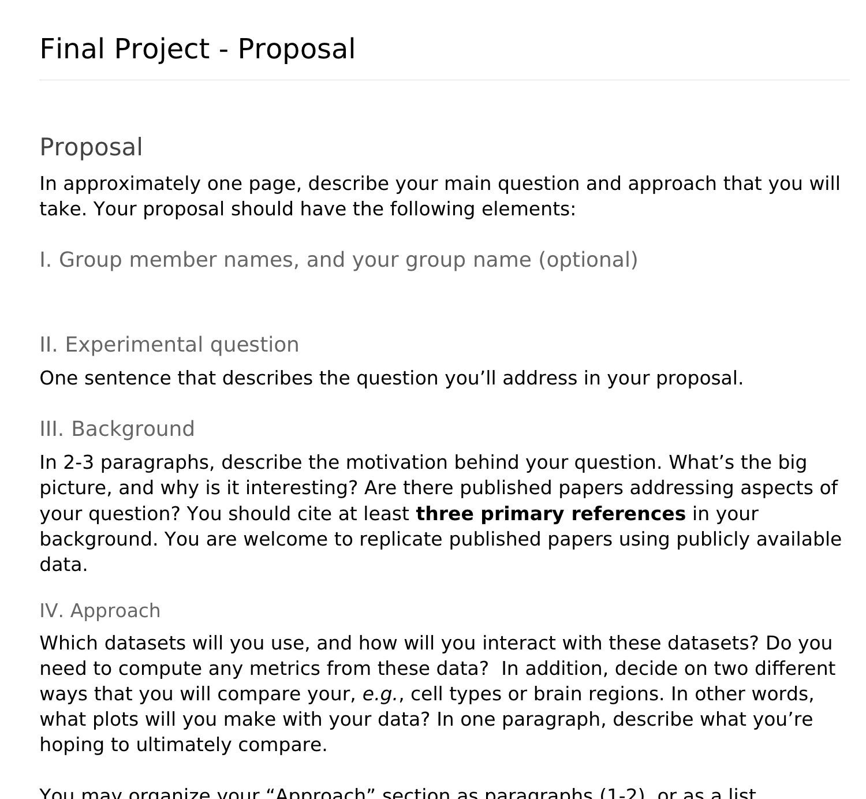
Questions about the Project Proposal (A3)? (due this Friday)
Reach out to Prof. Voytek or Eena if you need to be assigned to a group

Slide 3
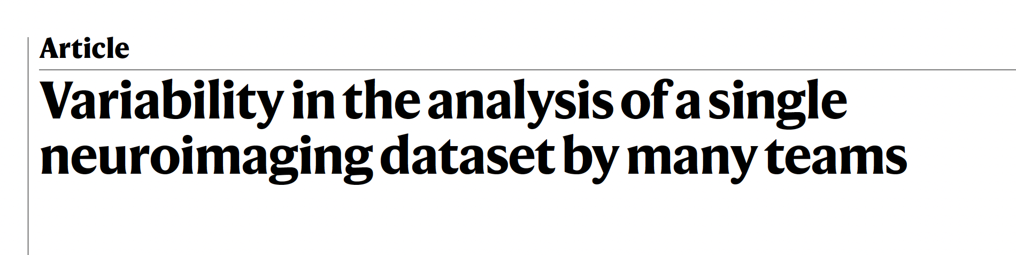
Reading #3
Notes:
Quiz due this Friday

Slide 4
There are so many ways to analyze and interpret the same data.
What does that mean for reproducibility?

Slide 5
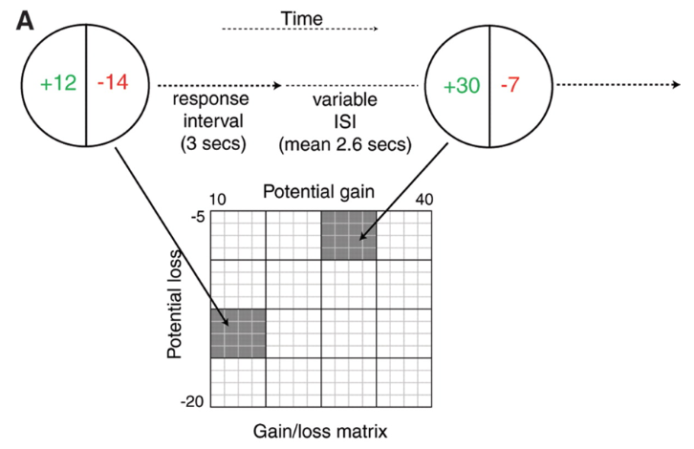
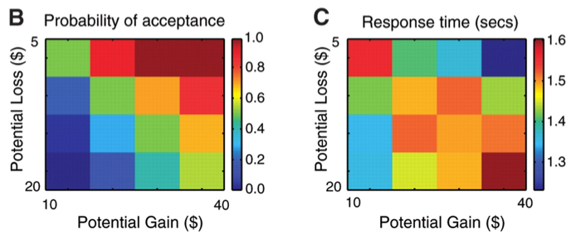
The Dataset:
fMRI
N = 108
Decision-making under risk task
Tom et al., 2007 Science
Notes:
(A) An illustration of the event-related task design. During each trial, the participant was presented for 3 s with a display showing the size of the potential gain (in green) and loss (in red). After the accept or reject response, a variable interval was presented to allow for optimal deconvolution of fMRI responses to each trial (27). Gambles were not resolved during scanning. The values of gain and loss for each trial were sampled from the gain/loss matrix, as shown here for two example gambles; a gamble from each cell in this 16 × 16 matrix was presented during scanning, but the data were collapsed into a 4 × 4 matrix for analysis. All combinations of gains and losses were presented. ISI, interstimulus interval.
(B) Color-coded heatmap of probability of gamble acceptance at each level of gain/loss (red indicates high willingness to accept the gamble, and blue indicates low willingness to accept the gamble). (C) Color-coded heatmap of response times (red indicates slower response times, and blue indicates faster response times).

Slide 6
Who analyzed this data?
What were they asked to do?
70 individual teams of scientific researchers
→ 69/70 teams have published fMRI studies
Instructions:
“Perform the analysis as [you] usually would in [your] own research laboratory and report the binary decision on the basis of [your] own criteria for a whole-brain-corrected result for the specific region described in the hypothesis.”

Slide 7
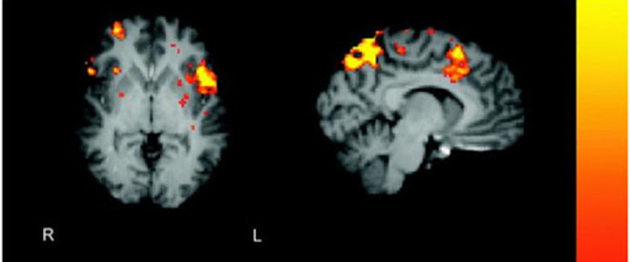
What did the teams turn in?
Yes/no answers to 9 hypotheses regarding the data/task
→ “Is ‘x’ neural activity related to ‘x’ feature of the task?”
Detailed report of all analyses performed
Unthresholded and thresholded statistical maps for each hypothesis
https://www.discovermagazine.com/mind/fmri-analysis-in-1000-words
Notes:
Helpful z-score fMRI refresher:
Each stimulus type is called an explanatory variable (EV). But how do we decide which ? scores are high enough to qualify as “activations”? Just by chance, some voxels which contain pure noise will have quite high ? scores
The answer is to calculate the t score, which for each voxel is ? / standard deviation of ? across the whole brain. The higher the t score, the more unlikely it is that the model would fit that well by chance alone. It’s conventional to finally convert the t score into the closely-related z score.
We therefore end up with a map of the brain in terms of z. z is a statistical parameter, so fMRI analysis is a form of statistical parametric mapping (even if you don’t use the “SPM” software!) Higher z scores mean more likely activation.
Note also that we are often interested in the difference or contrast between two EVs. For example, we might be interested in areas that respond to Faces more than Houses. In this case, rather than comparing ? scores to zero, we compare them to each other – but we still end up with a z score. In fact, even an analysis with just one EV is still a contrast: it’s a contrast between the EV, and an “implicit baseline”, which is that nothing happens.
Now we still need to decide how high of a z score we consider “high enough”, in other words we need to set a threshold. We could use conventional criteriafor significance: p less than 0.05. But there are 10,000 voxels in a typical fMRI scan, so that would leave us with 500 false positives.
We could go for a p value 10,000 times smaller, but that would be too conservative. Luckily, real brain activations tend to happen in clusters of connected voxels, especially when you’ve smoothed the data, and clusters are unlikely to occur due to chance. So the solution is to threshold clusters, not voxels.
A typical threshold would be “z greater than 2.3, p less than 0.05”, meaning that you’re searching for clusters of voxels, all of which has a z score of at least 2.3, where there’s only a 5% chance of finding a cluster that size by chance (based on this theory.) This is called a cluster corrected analysis.
Thus, after all that, we hopefully get some nice colorful blobs for each subject, each blob representing a cluster and colour representing voxel z scores:

Slide 8
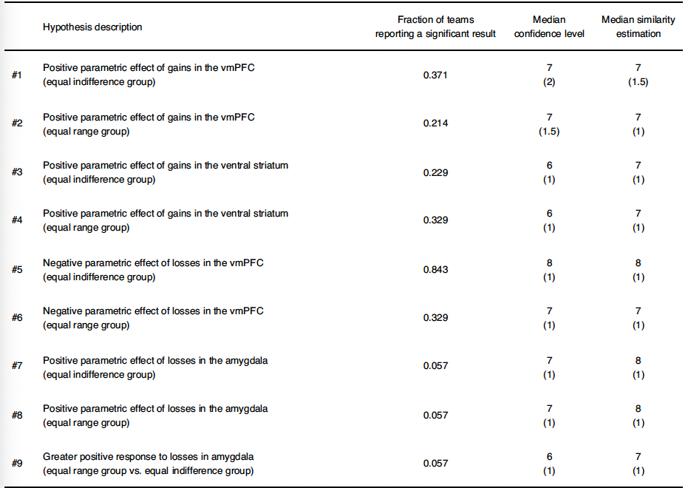
There was lots of variability across teams
"There were no two teams with identical analysis pipelines"
Notes:
20% of teams reported a result that differed from the majority of other teams

Slide 9
Teams were more likely to find significant results if…
They spatially ‘smoothed’ the data a lot
They used a specific fMRI software package
They used parametric instead of non-parametric multiple corrections testing
This should NOT determine statistical significance!
Notes:
Helpful smoothing info: http://jpeelle.net/mri/image_processing/smoothing.html
Convolving fMRI signal with Gaussian function of a specific width

Slide 10
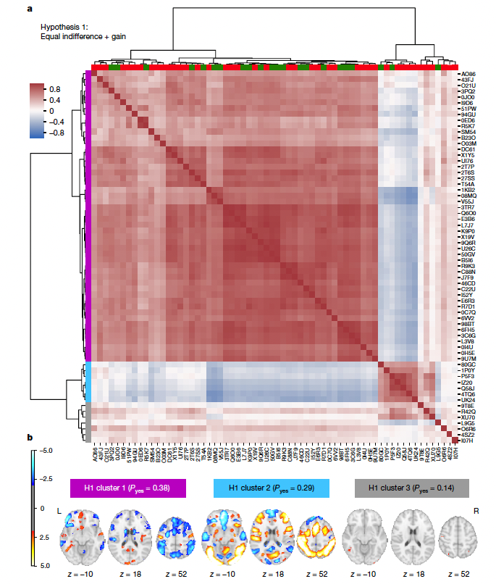
Variability in statistical maps
Lots of statistical maps were highly correlated with each other.
But: major inconsistencies with the agreement/disagreement with the hypotheses. (see green box)

Slide 11
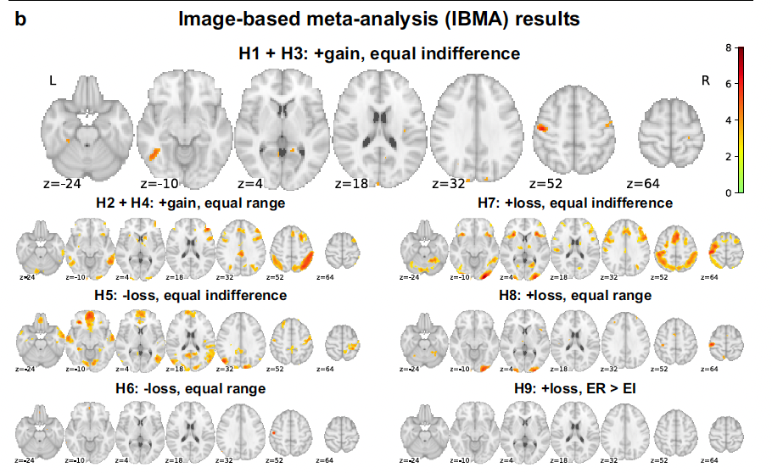
Image-Based Meta-Analysis
“Inconsistent results at the individual team level underlie consistent results when the results of teams are combined"
Notes:
Provides confirmatory evidence for hypotheses 2, 4, 5 and 6.
Results of the image-based meta-analysis.
A consensus analysis was performed on the unthresholded statistical maps to
obtain a group statistical map for each hypothesis, accounting for the
correlation between teams owing to the same underlying data
“Image-based meta-analyses allow for the use of hierarchical mixed effects models that account for intra-study variance and random inter-study variation”

Slide 12
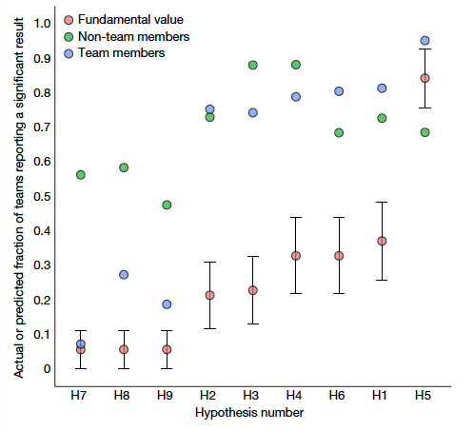
Prediction Markets: Can other scientists in the field predict these outcomes?
Team members were more correlated with the fundamental values than non-team members.
Optimism Bias: All researchers systematically overestimate the proportion of significance values across hypotheses.
Notes:
What is a prediction market?
Researchers trade $ based on the outcome of analyses
Had people who were a part of this analysis (team members market) AND people who weren't (non-team members market)

Slide 13
Where do we go from here…? 😳
1. We should share unthresholded statistical maps
2. We should be publicly sharing all data and analysis code
3. Complex datasets should be analyzed using several analysis pipelines AND by more than one research group
4. Analysis pipelines should be validated using simulated data to assess validity with regard to ground truth

Slide 14
General Announcements and Reminders
Project Proposal (A3) due this Friday (2/11/22) at 11:59 PM (PST)
Meet with your groups!
Let us know if you are not in a group yet
Reading Quiz due next Friday (2/18/22) at 11:59 PM (PST)
Reading quiz released TOMORROW
Three attempts
We will grade your last attempt, not your best attempt

